Slide 1


ANALYTICS USING PYTHON
#WE4TECH
Team Members:
Dishika Mehndiratta
Abhishek Sondkar
Sarvesh Chandratre
Prajwal Kaluse
Chinmay Ghatpande
Rushikesh Kathar

Slide 2

Understanding high school students grades from socio-economic factors such as family size, internet access, parent’s education levels and alcohol consumption patterns.
PROBLEM STATEMENT

Slide 3

Data Cleaning
Data Wrangling
Analysis
Missing values
Incorrect types
Outliners
Merging, combining and joining data
Data Munging
Data Remediation
Statistical Analysis
Visualization and representations
Correlation vs causation analysis

Slide 4

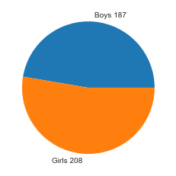
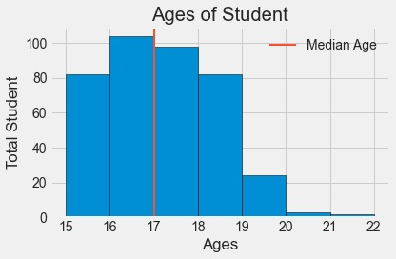
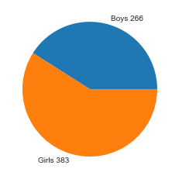
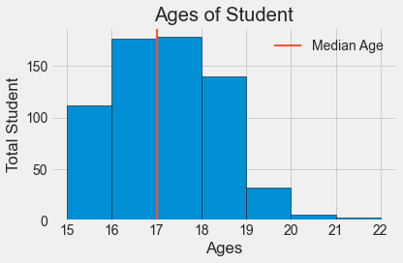
Description of data
Maths Dataset Number of Columns:33 Number of Rows:395 Null Values : 0
Portuguese Dataset Number of Columns :33 Number of Rows: 649 Null Values: 0

Slide 5
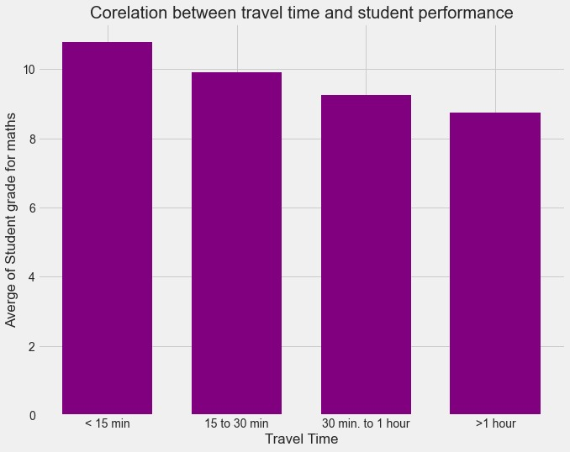
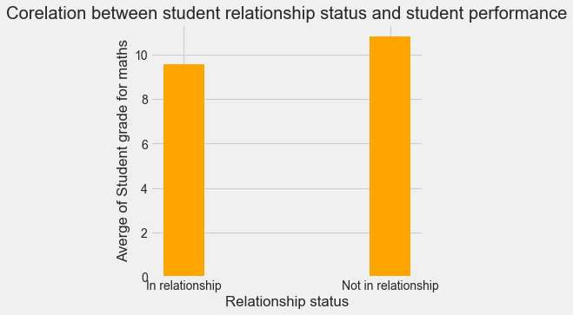
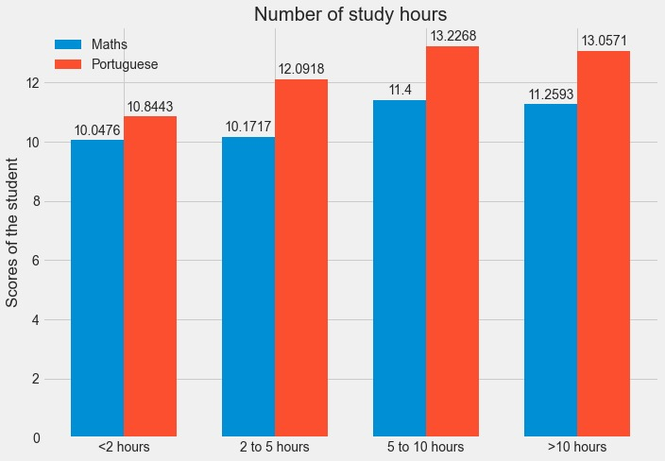
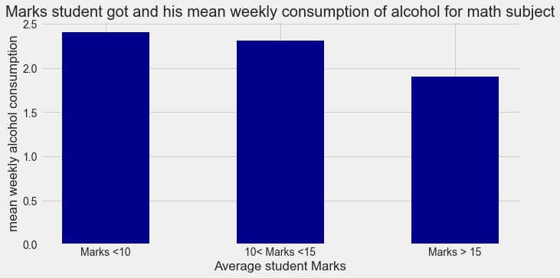
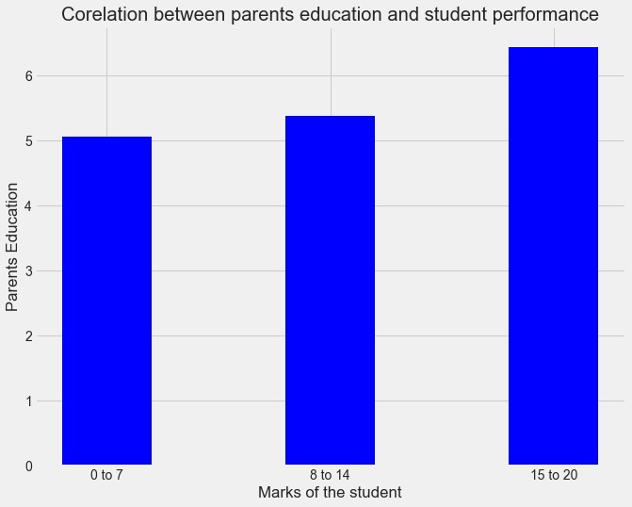
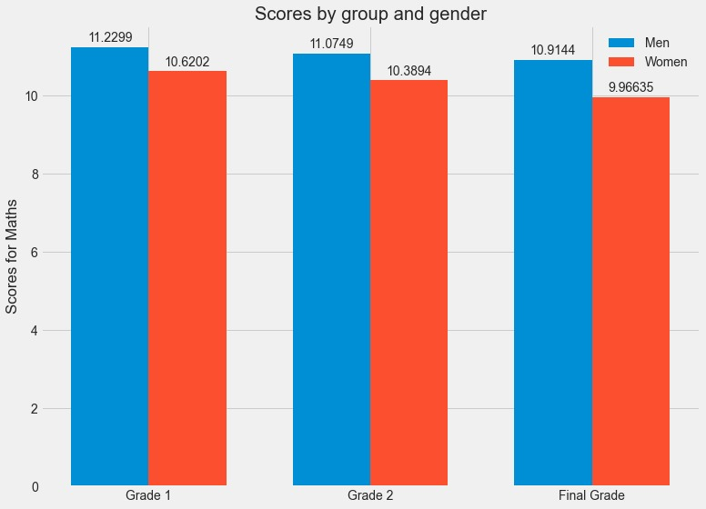
Visualisation Of Data

Slide 6
INSIGHTS
Using internet services seems to improve the performance of a student.
School affects the student performance like GP school seems to have greater average score than MS school.
Increasing the study hours will certainly help students to reduce his/her failures
Reducing consumption of the alcohol will certainly help students to increase academic performance.
Students in rural area seems to score lower than students in urban area in both the subjects.
Boys seems to perform better in maths while girls in Portuguese so joining maths paid classes will help the students to improve their performance but this cannot be implied for Portuguese.

Slide 7
RESULTS AND CONCLUSIONS
1)Co relation between travel time and student performance : % change=F-I/F=10.78-/11=18%
As per our analysis Suggest that student should reside near college to increase their performance, it has increased by 18%.
2)Co relation between student relationship and student performance: % Change=11-9/11=18%
As per our insights it is very clear that the personnel not in a relationship has a performance increase I 18%
3)Co-relation between scores of the students and number of study hours of the students: % Change(Maths subject)=(11.4-10.04/11.40)=11.9% % Change (Portuguese subject)=(13.22-10.84/13.22)=18%
As per the above % solution it is evident that studying for more hours improve performance
4) )Co-relation between Weekly consumption and student’s math marks: % change=2.4-1.9/2.4=20%
As per the above results is clear that there has been rise of 20% of marks by consumption of less alcohol
5)Co-relation between usage of internet during study and no internet usage during study: % improvement for maths subject if student uses internet=Mod(9.4-10.617/9.4)=12.9% % improvement for Portuguese subject if student uses internet =Mod(11.02-12.17/11.02)=10%
As per the data there has been an increased in the % of the performance where students use internet for their studies, to conclude studies should use internet to enhance there performance.
6)Co relation between subjects improvement and school selection: For Maths subject Gabriel Pereira students scored on average 6% more marks than student of Mousinho da Silveira
Again for Portuguese subject Gabriel Pereira students scored on average 16% more marks than student of Mousinho da Silveira
So as per the results it is very much clear that Gabriel pereira is performing better than Mousinho da Silveira. Therefore student should choose school based on their past student performance.

